Slide 1
Estimating species co-occurrence
物种共存估计

Slide 2
Rationale
原理
Several (say 2) different species on a site
Interactions affect occupancy probabilities
Detection of a species affected by presence of another one: blurred interactions
Examples: predation, mutualism, competition, …
一个地点有几个（比如2个）不同的物种
相互作用会影响物种的占用概率
一个物种的检测受到另一个物种存在的影响：相互作用模糊不清
例子：捕食、互惠、竞争……

Slide 3
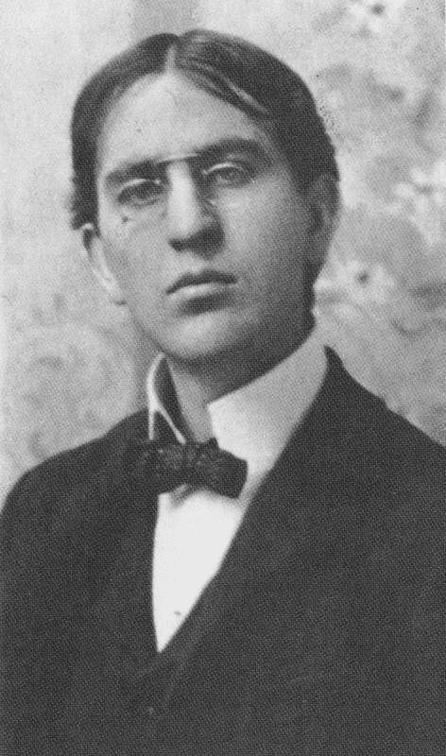
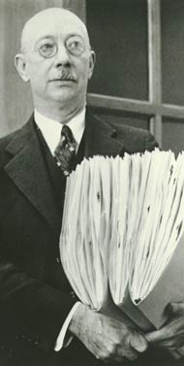
Why are certain species found together?
为什么某些物种被发现在一起？
1) Interactive Hypothesis - Clements
  community is an integrated set of species held together by the interaction of its members
  communities have emergent properties
  discrete boundaries between communities
  emphasizing studying assemblages
互动假说--克莱门茨
  群落是由其成员相互作用而维系在一起的一个完整的物种集合体
  群落具有独特的、整体性的特征
  群落之间存在离散的边界
  强调研究不同群落的组合
2) Individualistic Hypothesis – Gleason
  species share similar abiotic requirements
  no discrete boundaries between communities
  emphasizes studying single species
个体化假说--格里森
  物种具有相似的非生物要求
  群落之间没有明确的界限
  强调研究单一物种

Slide 4
Summary of Interspecific Interactions
种间相互作用概述
Type of interaction 互动类型 | Species 1 物种 1 | Species 2 物种 2
Competition竞争 | – | –
Consumer-Resource relationships 消费者-资源关系
Herbivory食草动物 | + | –
Predation捕食 | + | –
Parasitism寄生 | + | –
Mutualism互利/偏利共生 | + | +
Commensalism共生 | + | 0
Amenselism偏害共生 | 0 | –

Slide 5
Questions you might want to ask
你可能想问的问题
Are the species interacting or not? (beware: co-occurrence is not necessary interaction) 物种之间是否存在相互作用？（注意：共同出现并不一定是相互作用）
Do species interactions vary along an environmental gradient? 物种之间的相互作用会随着环境梯度的变化而变化吗？
What is marginal occupancy probability of some species (that is averaged on presence/absence of all other species) 某些物种的边际占用概率是多少（即所有其他物种存在/不存在的平均值）
What is probability of some species conditional on presence or absence of other species 以是否存在其他物种为条件，某些物种的概率是多少？
What is the relative contribution of environmental vs species interactions in occupancy? 在物种共存中，环境因素和物种之间的相互作用哪一个对物种出现的影响更大？

Slide 6
States
状态
U = site unoccupied
A = site occupied by species A only
B = site occupied by species B only AB = site occupied by both species
U=未被占用的地点。
A=仅由物种A占用的地点。
B=仅由物种B占用的地点。
AB=同时被物种A和B占用的地点。

Slide 7
State process
状态过程
ψ^{Α} = prob. a site is occupied by species A
ψ^{Β} = prob. a site is occupied by species B
ψ^{ΑΒ} = prob. a site is occupied by species A and B
ψ^{Α} =某地点被物种 A 占用的概率
ψ^{Β} = 某地点被物种 B 占用的概率
ψ^{ΑΒ} =某地点同时被物种A和B占用的概率

Slide 8
Conditional probabilities
条件概率
ψ^{Α|Β} = prob. a site is occupied by species A given presence of species B = ψ^{ΑΒ} / ψ^{Β}
ψ^{Β|Α} = prob. a site is occupied by species B given presence of species A = ψ^{ΑΒ} / ψ^{Α}
ψ^{Α|Β} = 在物种 B 存在的情况下，一个地点被物种 A 占用的概率= ψ^{ΑΒ} / ψ^{Β}
ψ^{Β|Α} = 在物种 A 存在的情况下，一个地点被物种 B 占用的概率 = ψ^{ΑΒ} / ψ^{Α}

Slide 9
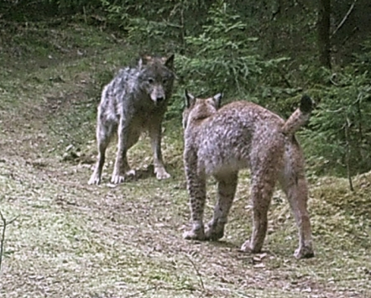
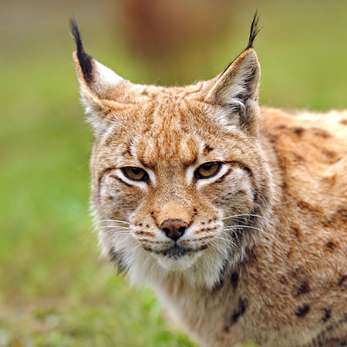
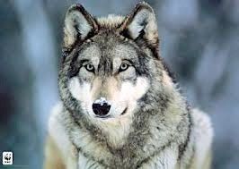
Venn diagram
维恩图解
Occupied by species A only仅被物种 A 占用 ψ^{Α} – ψ^{ΑΒ}
Occupied by species B only仅被物种 B 占用 ψ^{Β} – ψ^{ΑΒ}
Occupied by both species被两个物种占用ψ^{ΑΒ}
Site unoccupied with prob该地点未被占用的概率:
1 – ψ^{Α} – ψ^{Β} + ψ^{ΑΒ}

Slide 10
Events
事件
0 = species undetected 1 = A detected
2 = B detected
3 = both species detected
0 = 未检测到物种
1 = 检测到物种A
2 = 检测到物种B
3 = 同时检测到物种A和B

Slide 11
Observation process
观察过程
p^{A} = prob. detecting species A given only species A is present
p^{B} = prob. detecting species B given only species B is present
p^{A} = 在只有物种 A 存在的情况下检测到物种 A 的概率
p^{B} = 在只有物种 B 存在的情况下检测到物种 B 的概率
r^{AB} = prob. detecting both species A and B when both present
r^{Ab} = prob. detecting species A but not B when both present
r^{aB} = prob. detecting species B but not A when both present
r^{ab} = prob. detecting neither species when both present
r^{AB}= 当物种A和B同时存在时，同时检测到物种A和B的概率
r^{Ab} = 当物种A和B同时存在时，检测到物种A但未检测到物种B的概率
r^{aB} = 当物种A和B同时存在时，检测到物种B但未检测到物种A的概率
r^{ab} = 当物种A和B同时存在时，未检测到任何物种的概率

Slide 12
Initial states
初始状态
U
A
B
AB
_{ψ} A _{− ψ} AB _{ψ} B _{− ψ} AB _{ψ} AB
1− Σ

Slide 13
State process
State process
状态过程
U | A | B | AB
1 | 0 | 0 | 0
0 | 1 | 0 | 0
0 | 0 | 1 | 0
0 | 0 | 0 | 1
U A B
⎡
⎢
⎢
⎤
⎥
⎥
⎥
⎢
AB ⎢
⎥
⎣
⎦

Slide 14
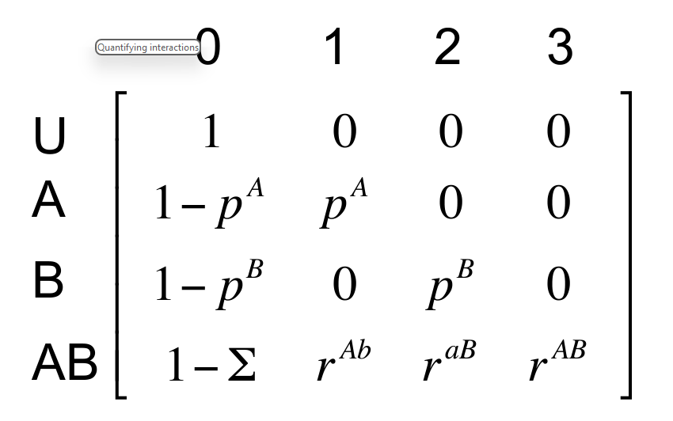
Observation process
Observation process
观察过程
p^{A} = prob. detecting species A given only species A is present
p^{B} = prob. detecting species B given only species B is present
p^{A} = 在只有物种 A 存在的情况下检测到物种 A 的概率
p^{B} = 在只有物种 B 存在的情况下检测到物种 B 的概率
r^{AB} = prob. detecting both species A and B when both present
r^{Ab} = prob. detecting species A but not B when both present
r^{aB} = prob. detecting species B but not A when both present
r^{ab} = prob. detecting neither species when both present
r^{AB}= 当物种A和B同时存在时，同时检测到物种A和B的概率
r^{Ab} = 当物种A和B同时存在时，检测到物种A但未检测到物种B的概率
r^{aB} = 当物种A和B同时存在时，检测到物种B但未检测到物种A的概率
r^{ab} = 当物种A和B同时存在时，未检测到任何物种的概率

Slide 15
Quantifying interactions
量化相互作用
Interaction estimated by: η = ψ^{ΑΒ} / (ψ^{Α} ψ^{Β})
η < 1 → avoidance (less frequent than expected)
η > 1 → convergence (more frequent than expected)
η = 1 → independence ( ψ^{ΑΒ} = ψ^{Α} ψ^{Β})
相互作用估计值（表示物种A和B在共存地点同时出现的概率与各自独立出现概率的比值）： η = ψ^{ΑΒ} / (ψ^{Α} ψ )^{Β}
η < 1 → 回避（物种A和B的共存概率低于预期）
η > 1 → 聚集（物种A和B的共存概率高于预期）
η = 1 → 独立（物种A和B的共存概率与各自独立出现的概率相等） ( ψ^{ΑΒ} = ψ^{Α} ψ )^{Β}

